Slide 1
DV1C04 Deployment and Monitoring in DevOps
L07
Repetitive Operations

Slide 2
Learning Objectives
Identify manual repetitive tasks
Describe the benefits of automate manual repetitive tasks
Perform manual task automation

Slide 3
Manual Repetitive Tasks
In IT operation, there used to be many manual tasks to be performed daily. This has taken up many man hours daily. By address manual repetitive works, many hours of administrators are free up and available for value-adding jobs.
Many companies face similar situations as below:
IT staff are overwhelmed with manual repetitive work.
IT administrators have little time for projects.
IT operation responses to business needs are as fast as the business wants.
Ref: https://www.infotech.com/research/ss/reduce-manual-repetitive-work-with-it-automation

Slide 4
Manual Repetitive Tasks
Administrators have many functions to perform, hence it is important to work efficiently and allow some tasks to essentially complete automatically.
Dedicated hosting tasks such as creating backup, adjusting multiple settings of servers etc. can be tedious but are necessary to keep servers running healthly. Automating repetitive tasks ensure man hours are free up and dedicated to important work.
Ref: https://www.reliablesite.net/hosting-news/automate-dedicated-server-tasks/#.YimoMXpBw2w

Slide 5
Automate Manual Tasks
Automation helps to achieve standardization and collaborate on daily activities, including:
Installing, configuring, and provisioning servers and applications
Updating and upgrading systems regularly
Monitoring, mitigating, and troubleshooting issues
Many essential daily tasks require manual steps that depend upon an individual's skills, creating inconsistencies and resulting in configuration drift. Carelessness in performing these manual, repeatable tasks can cause delays and issues to services availability due to human errors.
Manual daily tasks would be difficult if there are hundred and thousand of systems.
Ref: https://opensource.com/article/21/3/ansible-sysadmin

Slide 6
Benefits of Automation
Some of the reason to automate are:
Ensure a consistent and stable environment.
Foster standardization.
Ensure high availability and fewer severe incident cases
Ensure lesser issue to troubleshoot
Ref: https://opensource.com/article/21/3/ansible-sysadmin

Slide 7
Operational Tasks
There are many operational tasks that are performed by operation team. The following covers some of the essential operational tasks:
Monitoring and Alerting
Monitoring and alerting across applications and infrastructure are always ongoing. Monitoring core server and network metrics like CPU, disk usage, DNS, latency help detect incident(s). Alerts trigger on-call notifications in case of any major incidents.
Ref: https://www.splunk.com/en_us/blog/devops/the-definitive-guide-for-being-a-system-administrator.html

Slide 8
Operational Tasks
User Permission and Administration
User permissions determine the rights to administrate various applications and services. User roles are assigned to manage the various organization’s IT stack, allowing users the access they need to certain applications and services in a secure way.
Password Management
Passwords management is an ongoing task in company. It includes reset passwords and ensure security requirements are met everywhere.
Ref: https://www.splunk.com/en_us/blog/devops/the-definitive-guide-for-being-a-system-administrator.html

Slide 9
Operational Tasks
File Organization and Management
To ensure data organization and consistency, policies and procedures are needed to ensure files are organized and shared within the organization. These ensure security is in place to defend external attacks as well as ensuring appropriate, easy access to files for employees.
Software Installation, Updates and Upkeep
Policies and procedures should be in place to keep up with software installation and updates. Any errors with new updates or interdependencies between new versions of systems, it can be detected these issues and fixed.
Ref: https://www.splunk.com/en_us/blog/devops/the-definitive-guide-for-being-a-system-administrator.html

Slide 10
OperationalTasks
Security
Security should be top-of-mind for any implementation and operation. Operation Team should perform all actions in a secure way. As networks and servers are setup, IT team need to do it in a technically sound and secure way.
Ref: https://www.splunk.com/en_us/blog/devops/the-definitive-guide-for-being-a-system-administrator.html

Slide 11
Operational Tasks
Problem Solving
While the speed of applications deployment increases, it also mean the speed of rolling out of such setup into operate phase also increases. So, finding ways to reduce bottlenecks in the operation while simultaneously ensuring security in various setups are always ongoing.

Slide 12
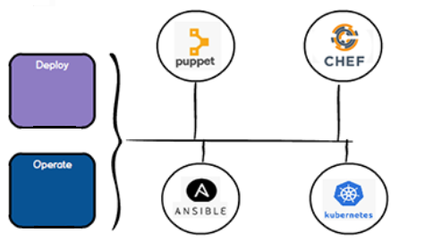
Tools for Operation
In order to automate manual operation tasks, there are several tools available as shown below

Slide 13
Puppet Bolt
Bolt is an open source and agentless tool. It is ready for any user, any language, any OS. AND no Puppet experience or agents necessary. Existing scripts and plans, including YAML, PowerShell, Bash, Python or Ruby, or content from the Puppet Forge can be used with Bolt.
Bolt is useful when you want to perform works remotely, especially when many servers are involved. Bolt uses ssh protocol in performing tasks remote.
Bolt can be executed via
Command
Script
Task
Plan
Ref: https://puppet.com/open-source/bolt/

Slide 14
Run a command on a target
The syntax to run a command is:
bolt command run <COMMAND> --targets <TARGET_NAME> <OPTIONS>
For example: use Bolt to run simple commands on a target machine, in this case, a localhost.
$ bolt command run whoami -t 127.0.0.1 -u root -p root --no-host-key-check
Where -t => targets
-u => user
-p => password
--no-host-key-check => Not checking host keys with SSH.
Ref: https://puppet.com/docs/bolt/latest/bolt.html

Slide 15
Run a command on a target
Example: Use the following command to stop ntp service on target1:
$ bolt command run 'systemctl stop ntpd’ --target ssh://target1 --user dockeradm ---password ‘<password>’ -no-host-key-check - -run-as root
(replace <password> with the actual password)
Where
--no-host-key-check option allows the command run without an entry in the SSH known_hosts file. Default behavior of Bolt is to validate SSH key signatures for security purposes.
--run-as allows permission escalations. User is authenticated as dockeradm and then changing the user to root (via sudo) when the script executes.
Ref: https://puppet.com/docs/bolt/latest/bolt.html

Slide 16
Run a Script on a target
A script can be run against remote hosts using bolt. For example, you have a script, which is on your local machine, which is needed to perform some tasks on multiple machines simultaneously.
For example, a local script can be executed through bolt command to set message of the day (motd) on remote machine(s). Another example is Puppet bolt can be used to deploy and configure NTP, and prints a simple inventory report.
Ref: https://puppet.com/docs/bolt/latest/bolt.html

Slide 17
Run a Script on a target
The syntax to run a command is:
bolt script run <script> --targets <TARGET_NAME> <OPTIONS>
Use the following command to stop ntp service on target machince e.g. puppetclient.localdomain:
bolt script run \tools\linux.sh --targets ssh://puppetclient1.localdomain --user dockeradm - -password ‘<password>’ --no-host-key-check --run-as root
--run-as allows permission escalations. User is authenticated as dockeradm and then changing the user to root (via sudo) when the script executes.
Ref: https://puppet.com/docs/bolt/latest/bolt.html

Slide 18
Run a Task on a Target
Tasks are single actions that you can execute on a target. They are similar to scripts, but have metadata, accept structured input, and return structured output. You can write tasks that are specific to your project or download modules from the Puppet Forge that include tasks.
The syntax to run a command is:
bolt task run <task> --targets <TARGET_NAME> <OPTIONS>
For example:
$ bolt task run facts --targets puppetclient1.localdomain - -user ddockeradm - -password ‘<password>’ - -no-host-key-check –run-as root
Ref: https://puppet.com/docs/bolt/latest/running_bolt_commands.html

Slide 19
Run a Task on a Target
More example on puppet “bolt task”. The following example show what puppet task can do on remote server. The following command run puppet resource package
$ bolt task run package action=status name=apache2 --targets puppetclient.localdomain - -user dockeradm - -password ‘<password>’ - -run-as root
The above command displays the status of package apache2 of remote target puppetclient1
Ref: https://puppet.com/docs/bolt/latest/running_bolt_commands.html

Slide 20
Run a Task on a Target
The below command install the package apache2 on remote target puppetclient1
$ bolt task run package action=install name=apache2 - -targets puppetclient1.localdomain - -user dockeradm - -password ‘<password>’ - -run-as root
Note: in order for - -run-as root to be effective, the user dockeradm needs to be able to do sudo on the target system.
Ref: https://puppet.com/docs/bolt/latest/running_bolt_commands.html

Slide 21
Run a Plan on a Target
Plan is useful if you have multiple tasks or complex workflow to be execute.
The syntax to run a command is:
bolt plan run <module::plan> --targets <TARGET_NAME> <OPTIONS>
The below command execute the plan “plan_a” from module module_a on remote target puppetclient1
$ bolt plan run module_a::plan_a - -targets puppetclient1.localdomain - -user dockeradm - -password ‘<password>’ - -run-as root
Ref: https://puppet.com/docs/bolt/latest/running_bolt_commands.html

Slide 22
Run on Multiple Targets
To run command, script or task on multiple targets, multiple servers need to be specified using -- targets option.
--targets client1,client2,…..client
Or
-t targets client1,client2,…..client

Slide 23
Run on Multiple Targets
Bolt command example:
bolt command run whoami -t puppetclient1,puppetcilent2 -u dockeradm -p ‘<password>’ --no-host-key-check
Bolt script example:
bolt script run ‘\tools\linux.sh’ --targets ssh://puppetclient1.localdomain --user dockeradm - -password ‘<password>’ --no-host-key-check --run-as root
Bolt task example:
bolt task run package action=install name=apache2 - -targets puppetclient1,puppetclient2 - -user dockeradm - -password ‘<password>’ - -run-as root

Slide 24
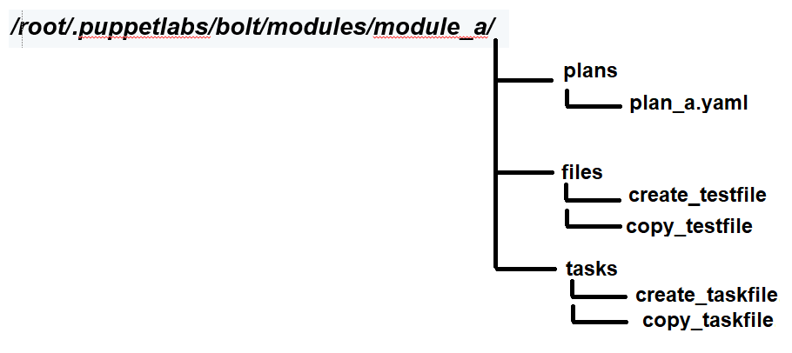
Create custom task and plan
Custom Task and Plan can be created. Take a look at the module structure.
For example, the following module structure is created:

Slide 25
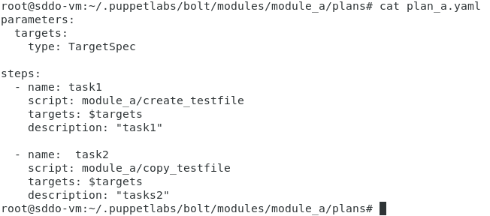
Plan Files in Plan Directory
plan_a.yaml

Slide 26


Files in Files Directory
create_testfile
copy_testfile

Slide 27
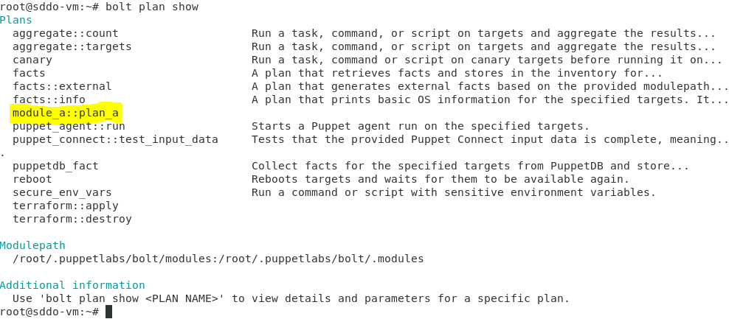
Bolt plan List
There are several built-in tasks for puppet bolt. To list the task list, issue the following command;
bolt plan show
Ref: https://puppet.com/docs/bolt/latest/inspecting_tasks.html

Slide 28

Task Files in Tasks Directory
create_taskfile
copy_taskfile

Slide 29
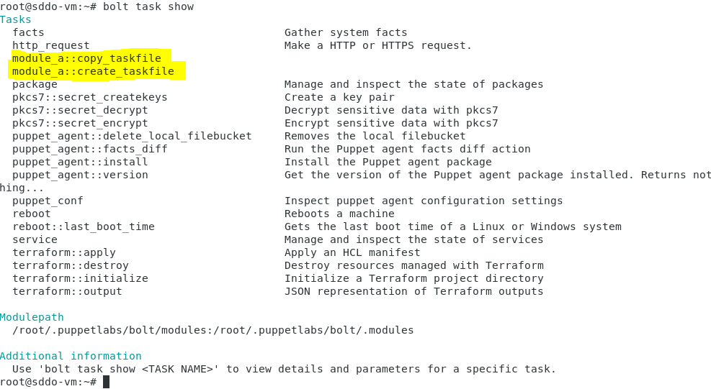
Bolt Task List
There are several built-in tasks for puppet bolt. To list the task list, issue the following command;
bolt task show
Ref: https://puppet.com/docs/bolt/latest/inspecting_tasks.html

Slide 30
Reference
https://www.splunk.com/en_us/blog/devops/the-definitive-guide-for-being-a-system-administrator.html
https://www.infotech.com/research/ss/reduce-manual-repetitive-work-with-it-automation
https://puppet.com/docs/bolt/latest/running_bolt_commands.html

Slide 31
Thank you

